Slide 1
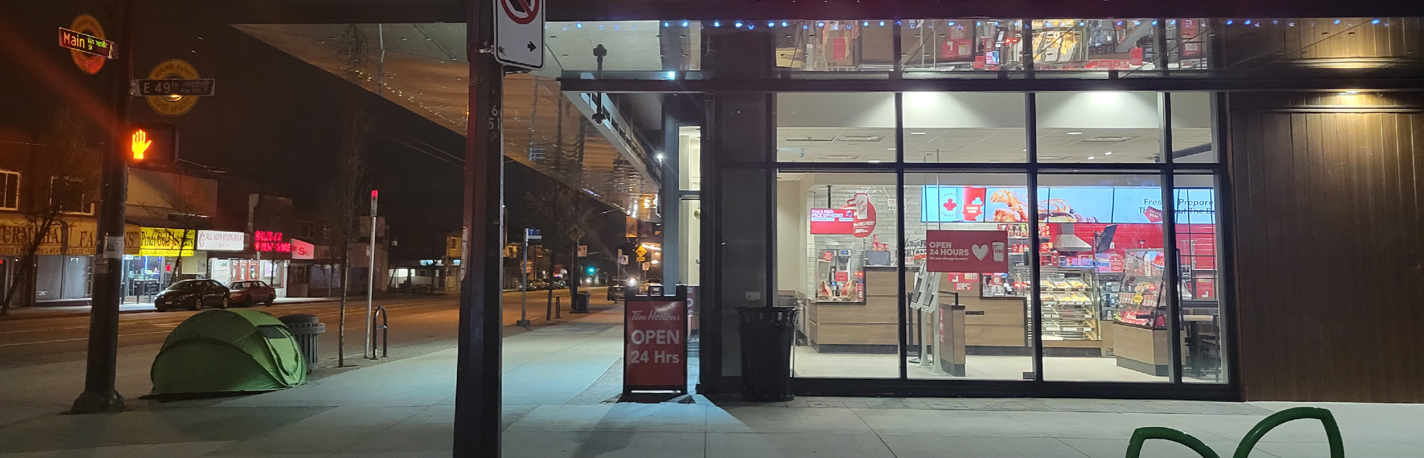
Experiencing Homelessness in South Vancouver
Prepared for the South Vancouver Neighbourhood House Community Hub for Homelessness
November, 2022

Slide 2
Do we even have homelessness here?
There’s been no city-wide homeless count since before the pandemic.
No obvious place to start gathering data in South Vancouver
  No shelters
  Very few relevant services in this area
  Community organizations serving South Van were reluctant to go on record, but did offer insights and advised where to conduct street outreach.

Slide 3

The short answer is yes.
Estimates from organizations in the community
  “Dozens”
  “Hundreds” (200-300)
  10-20 per night at Langara EWR
  1 request per day for visits from the PHS Needle Exchange van from unhoused or precariously housed clients in this area.

Slide 4
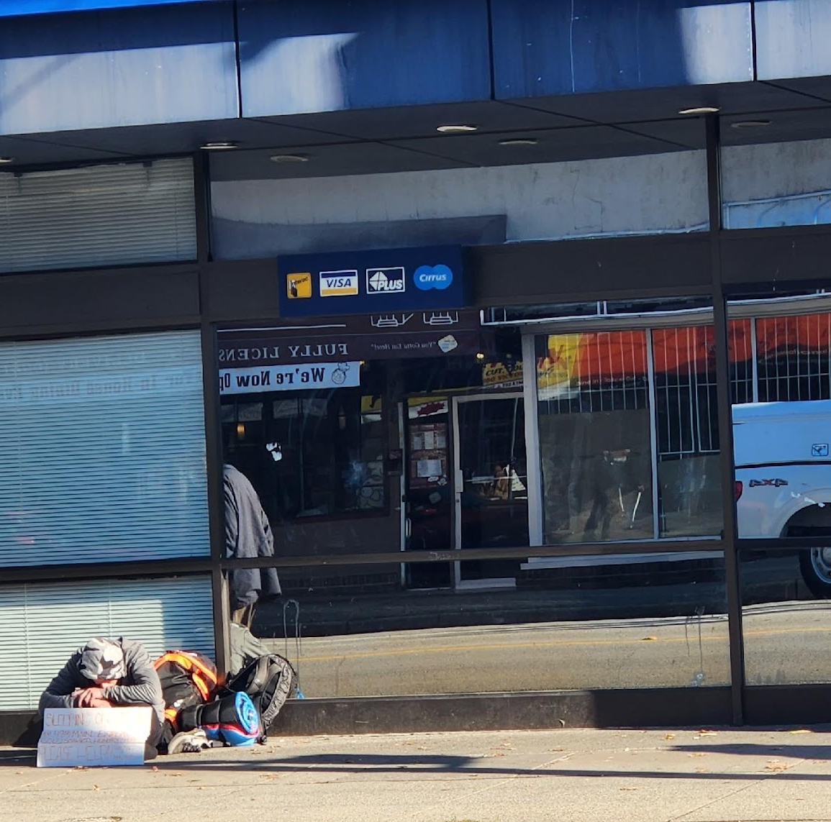
Objectives of the research
Three levels of investigation
  Individuals experiencing homelessness
  The general community
  Local businesses
Who is homeless, and why?
What are we doing to help in South Vancouver?
How do people feel about it?

Slide 5
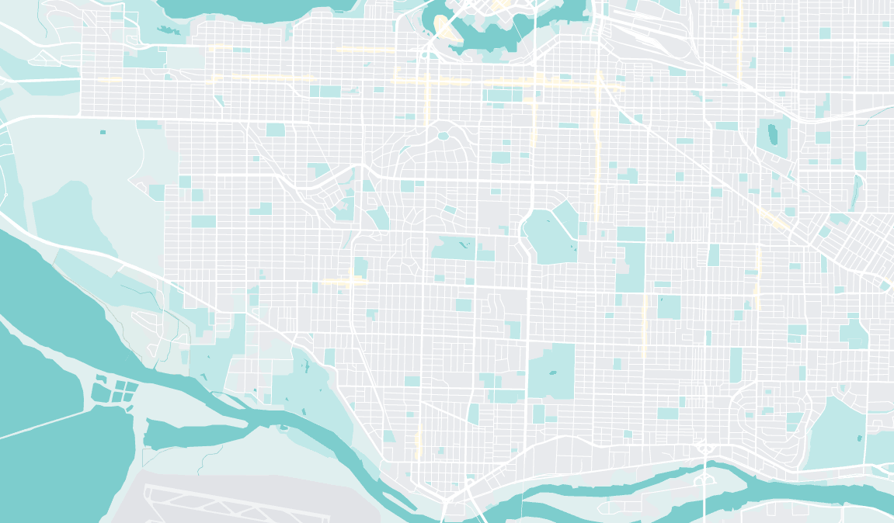
Methodology
Limitations:
  Difficult to reach people who were experiencing “invisible” homelessness.
  Not everyone who may have been homeless was willing to talk to me
    Language barriers
    Lack of privacy
  Many people don’t stay here.
  Stigma, shame, ambiguity in definitions
Outreach was conducted on foot over the course of 3 months throughout South Van.
Guided largely by word of mouth, by asking members of the community—both housed and unhoused—where I should look for people who were experiencing homeless.
The results reflect conversations with 31 individuals who self-identified as homeless.
Participation was entirely voluntary and questions were open-ended.
Qualitative more than quantitative – themes and keywords that were later categorized.

Slide 6
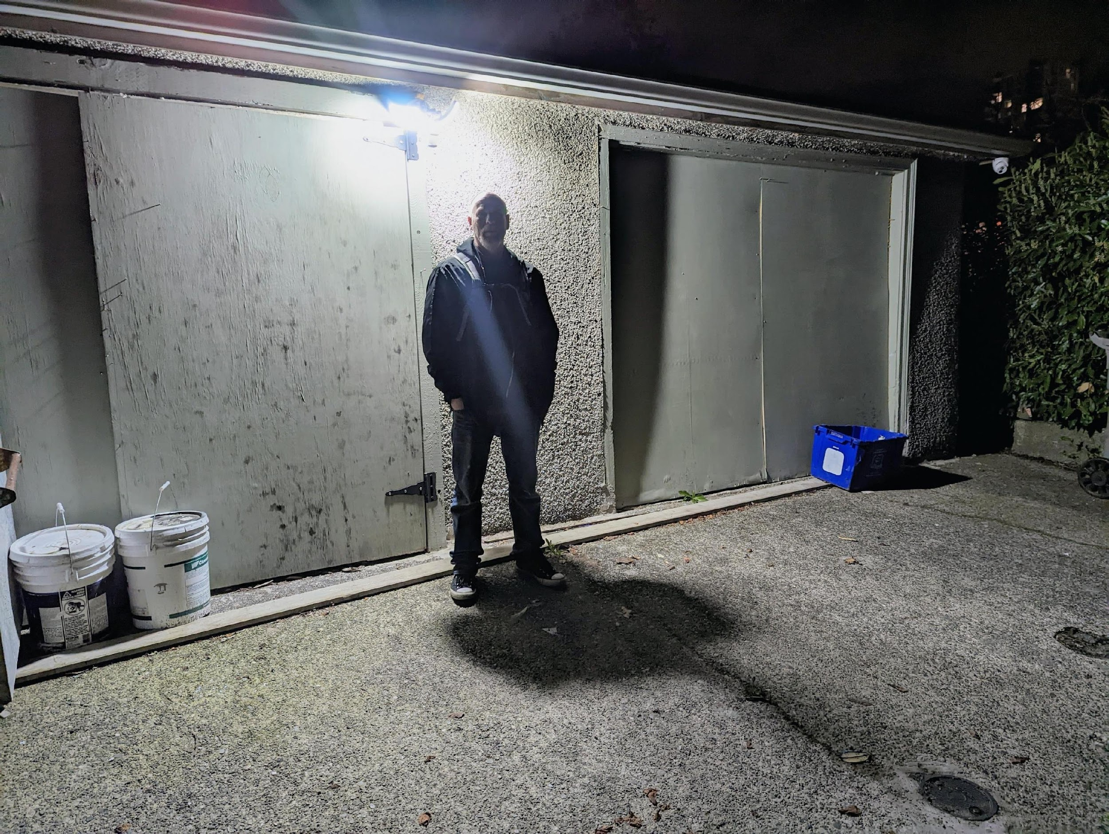
Terry became homeless following a house fire in December 2021.
He lost his job shortly thereafter. He struggles with PTSD he can’t afford to treat, and depression.

Slide 7
Why are you homeless?
Precarious living situation, followed by crisis
  Interpersonal conflict (including divorce) - 25% (8)
  Housefire – 19% (6)
  Eviction - 16% (5)
Affordability: Housing in Vancouver is too expensive – 58% (18)
Negative cycle: it’s hard to get back up after you’ve fallen down. – 51% (16)
  Includes answers like “I’ve been homeless for a long time”

Slide 8
Trends
New to Vancouver
  Smaller cities, towns in BC (Kelowna, Kamloops, Vancouver Island) – 25%
  Other Provinces (Ontario, Yukon) - 16%
Lack of pet-friendly housing options - 19% (6)
  Four different “families” of people seeking housing with large breed dogs
May or may not receive Disability or Income Assistance
  Yes – 21 (67%)
  No – 10 (32%)
Unsure where to go for help, how to navigate services - 52%

Slide 9
Why are we in South Vancouver?
Personal relationships
  Friends who live here
  Transition and recovery houses in the area
  Substance use connections, either current or past
Cheap (shared) housing
  Single family residences/duplexes divided into many “bedrooms”
People are friendly
  Fewer interactions with police
  Less hostility in public places
SPACE
  Fewer people, less crowded
  Easier to find a quiet place and not be disturbed

Slide 10
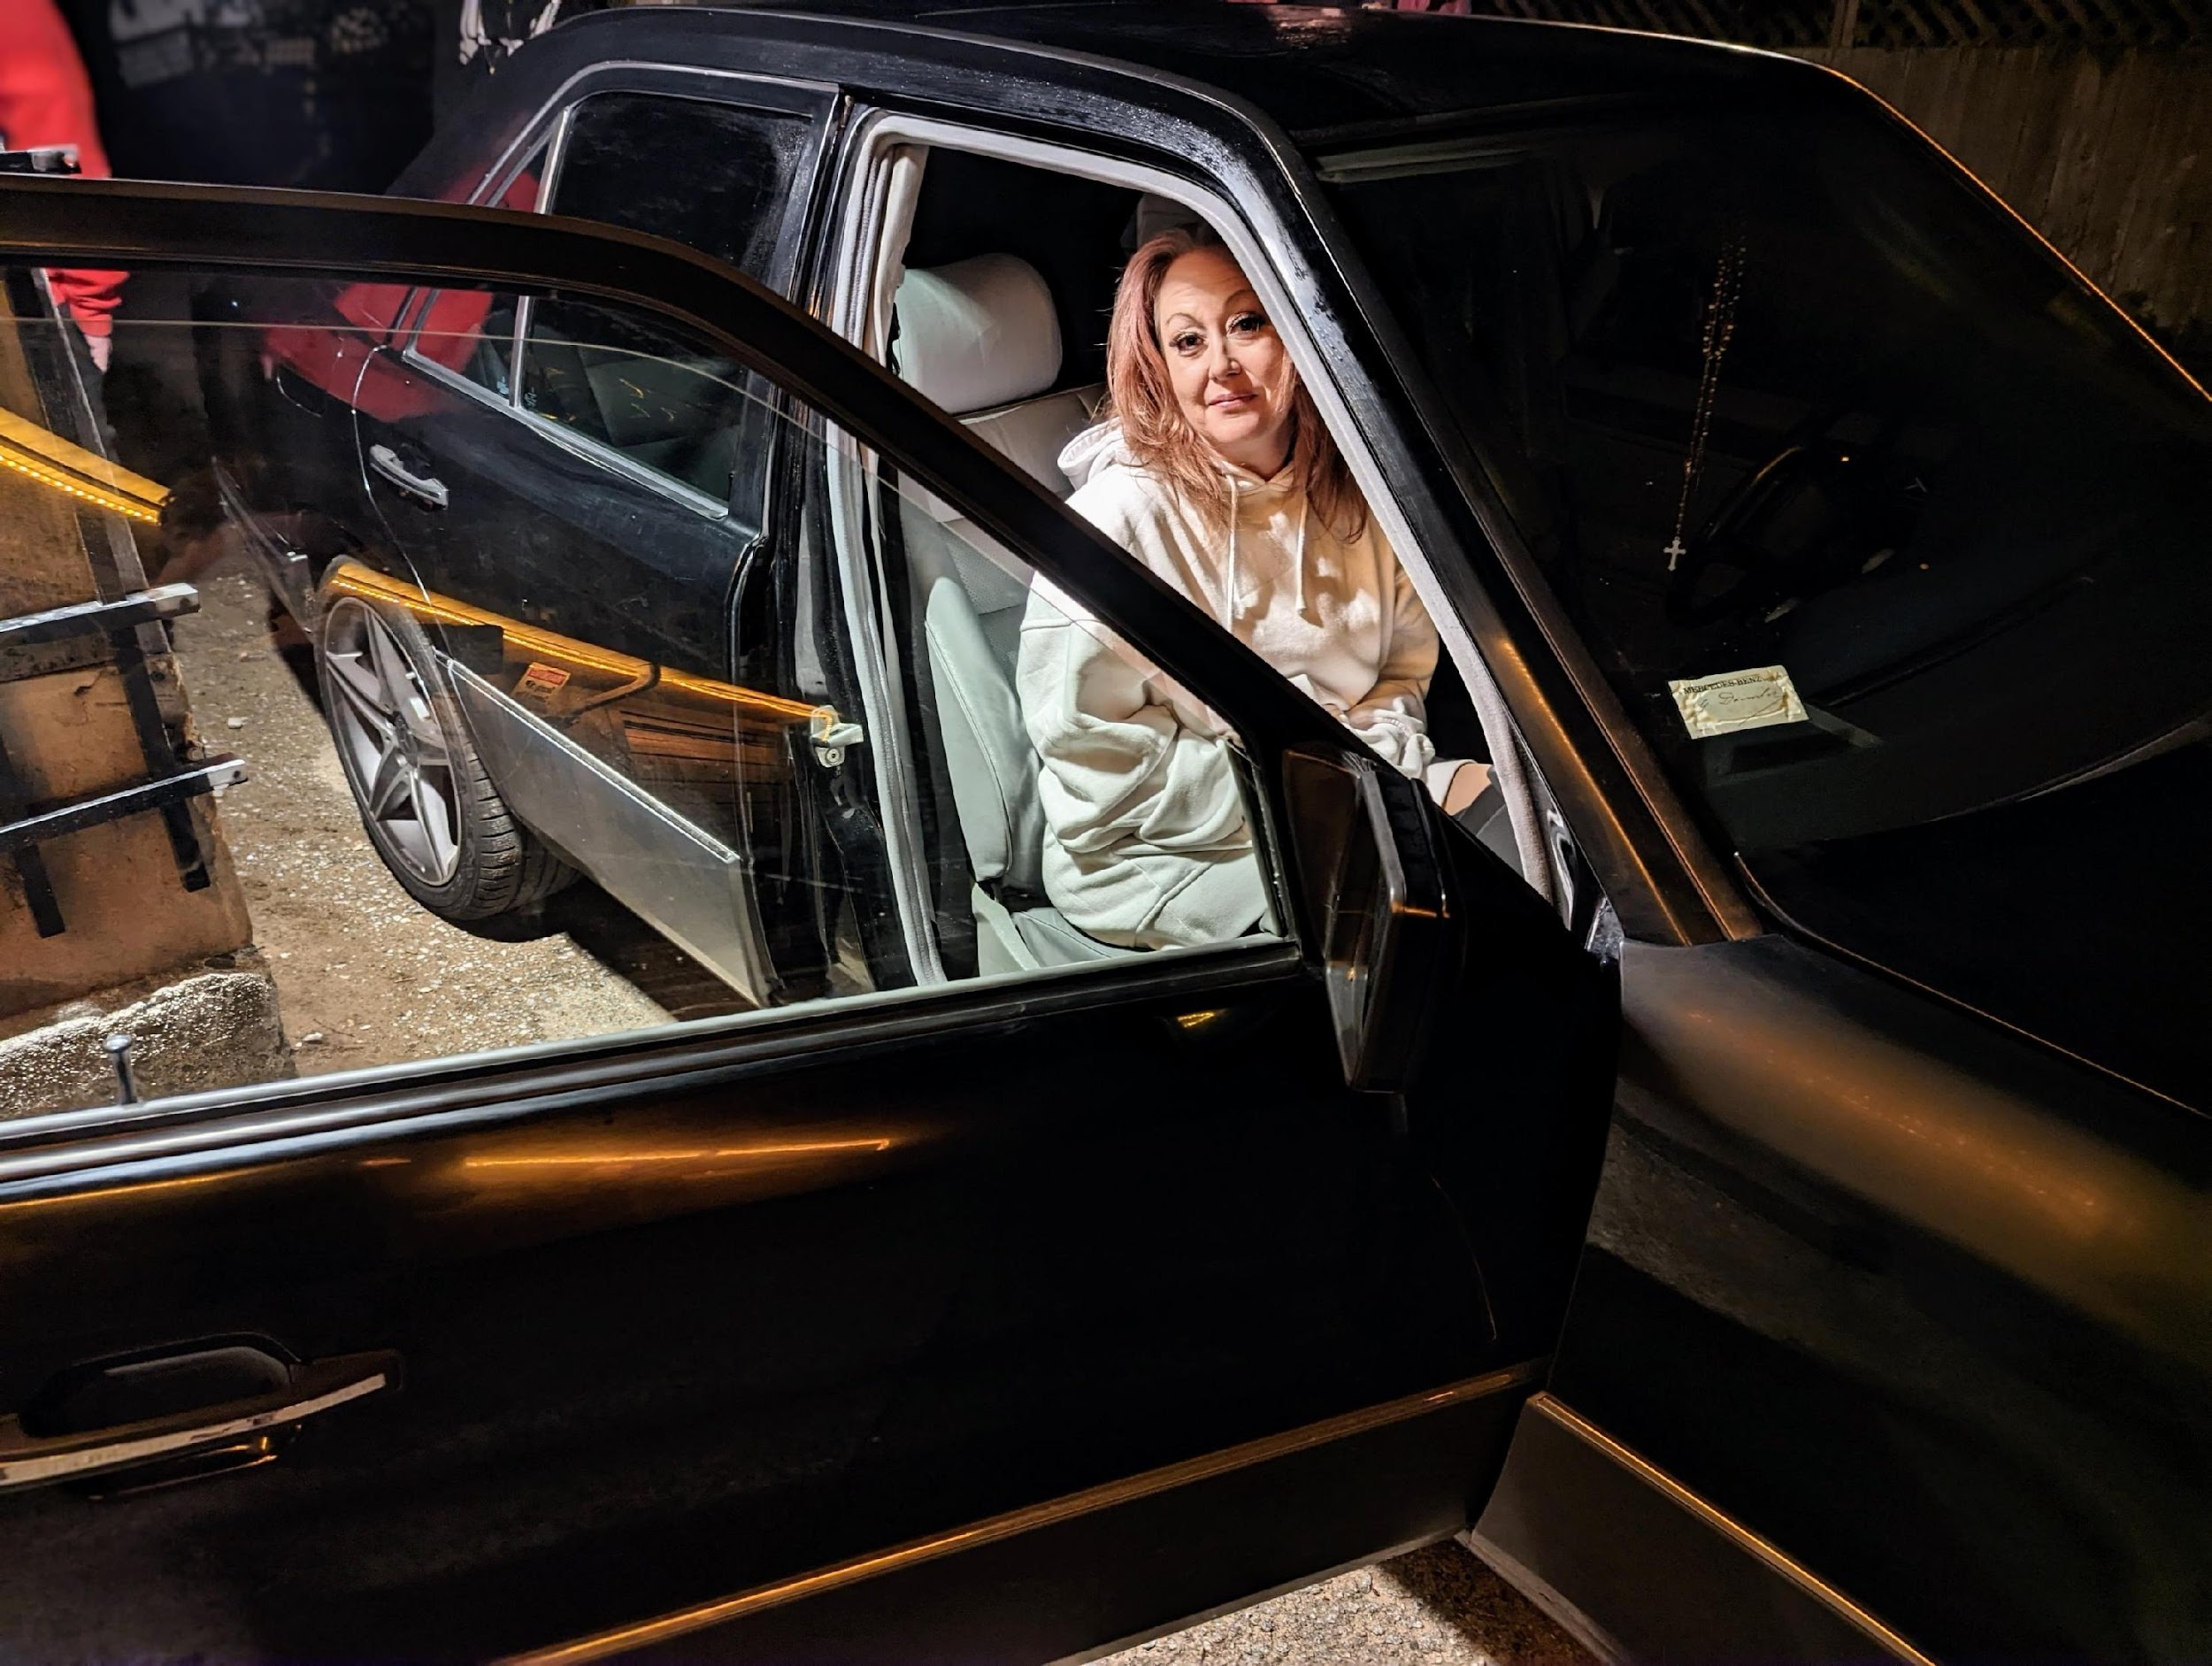
Betty stays with friends when she can, but mostly lives out of her car.

Slide 11
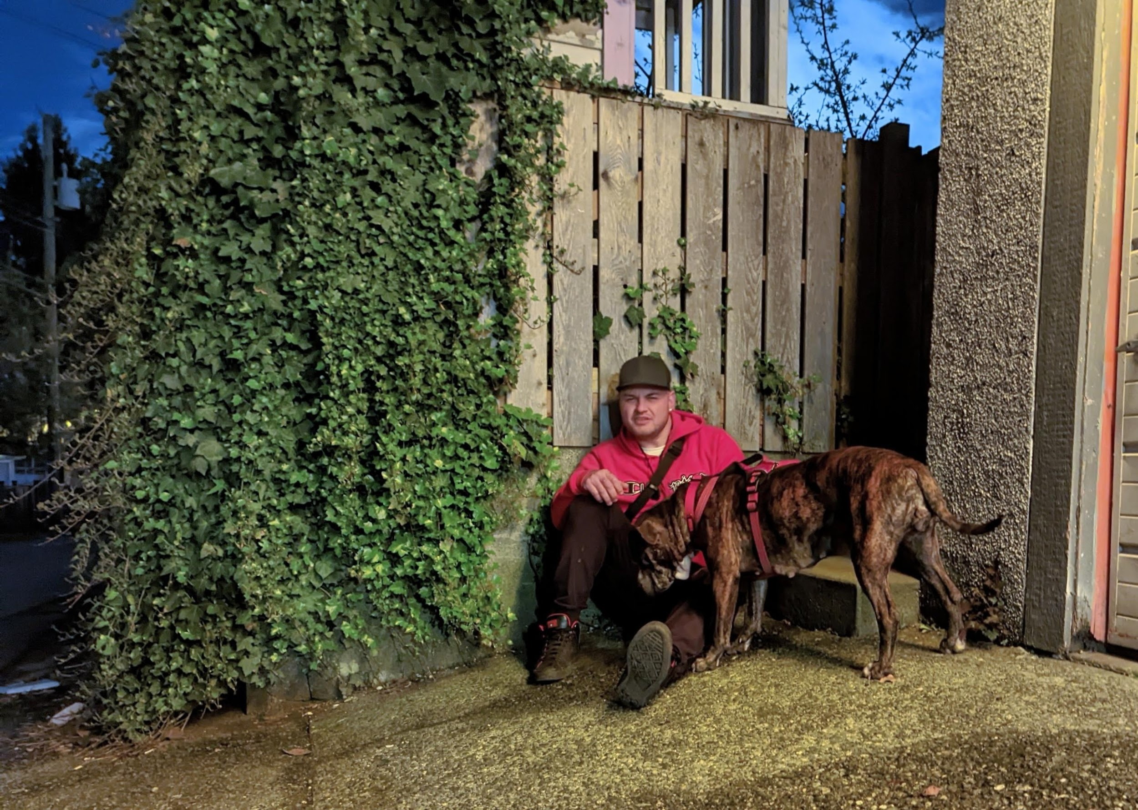
This young man comes from a small town in Northern BC. He came to Vancouver after spending time in jail and found it too hard to go back to his small community.
He couch surfs when he can and he stays up all night when he can’t.

Slide 12
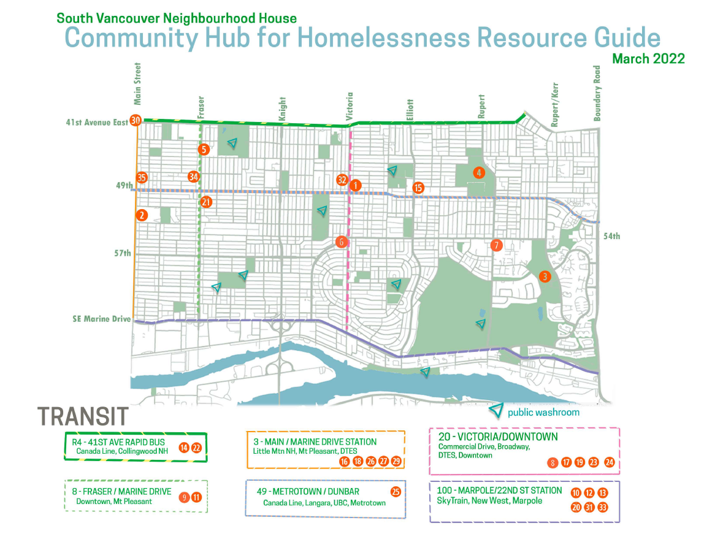

Slide 13
Local Resources – findings
Food
  Mostly weekly grocery hamper distribution
    Of limited use to people with no fridge
    Most Food Banks require ID and/or proof of residency in the area served by FB
  Weekly free meals available in nearby Marpole, Collingwood, Riley Park areas.
Harm reduction
  Preventative HR supplies and Naloxone kits available through Vancouver-wide mobile outreach programs
    All of these are based in DTES, and come here roughly once a day, when convenient
    Can also be found at locations in Marpole, Collingwood, Riley Park
  A handful of pharmacies carry Naloxone.

Slide 14
Shelter
  None.
  EWR shelter at Langara YMCA (when temperatures fall near 0C)
  Virtually all year-round shelters are in the DTES/Downtown, and have little space. The closest one is Yukon Shelter, Yukon and W 2nd Ave.
Telephone and Computer access, electrical outlets
  Libraries – Fraserview, Champlain Heights, and South Hill
  Community centers – Killarney, Sunset, and Champlain Heights
Clothing
  Value Village may offer clothes to people in need when referred by local non-profits…but nobody knew what organizations or how.
  There are programs available outside SV, mostly Downtown and DTES.

Slide 15
Washrooms
  Only one business said they would be willing to let people experiencing homelessness use their washrooms and agreed to be included on the list.
    FYI, it was the Chevron at Main and 41st (they also give people free coffee ☺)
    Even non-profit community organizations said no.
    COVID-19 safety concerns were a factor
  That leaves…
    public park bathrooms (open dawn-dusk, many closed during winter months)
    Libraries and Community Centers (during opening hours)
      …that’s it.
Showers
  Killarney community center, CNH Morning Star Breakfast

Slide 16
What do you think would be helpful?
Homes (20)
  Majority said this was what they most needed, many presented it as a joke.
Access to phones and internet (18)
  Employment, housing, relationships with family all difficult without this
  Suggestions included message boards, voicemail systems, free SIM cards with basic plans.
Storage for personal belongings (10)
  Without laundry and a safe place for clothes, some people spend a large percentage of their income on clothes every month, then throw them out.
Private showers (8)
  Many people were not showering, and those who were said they did so in communal showers (mostly at shelters)

Slide 17
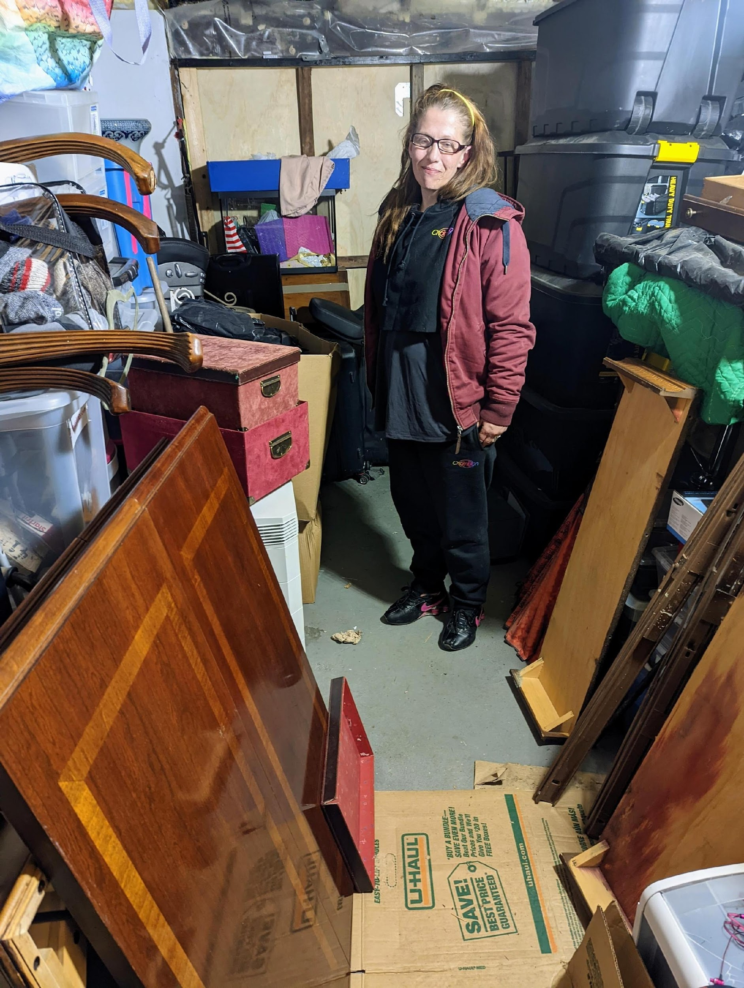
Tasha spends $450 per month on storage while she looks for a new home for her and her cat.

Slide 18
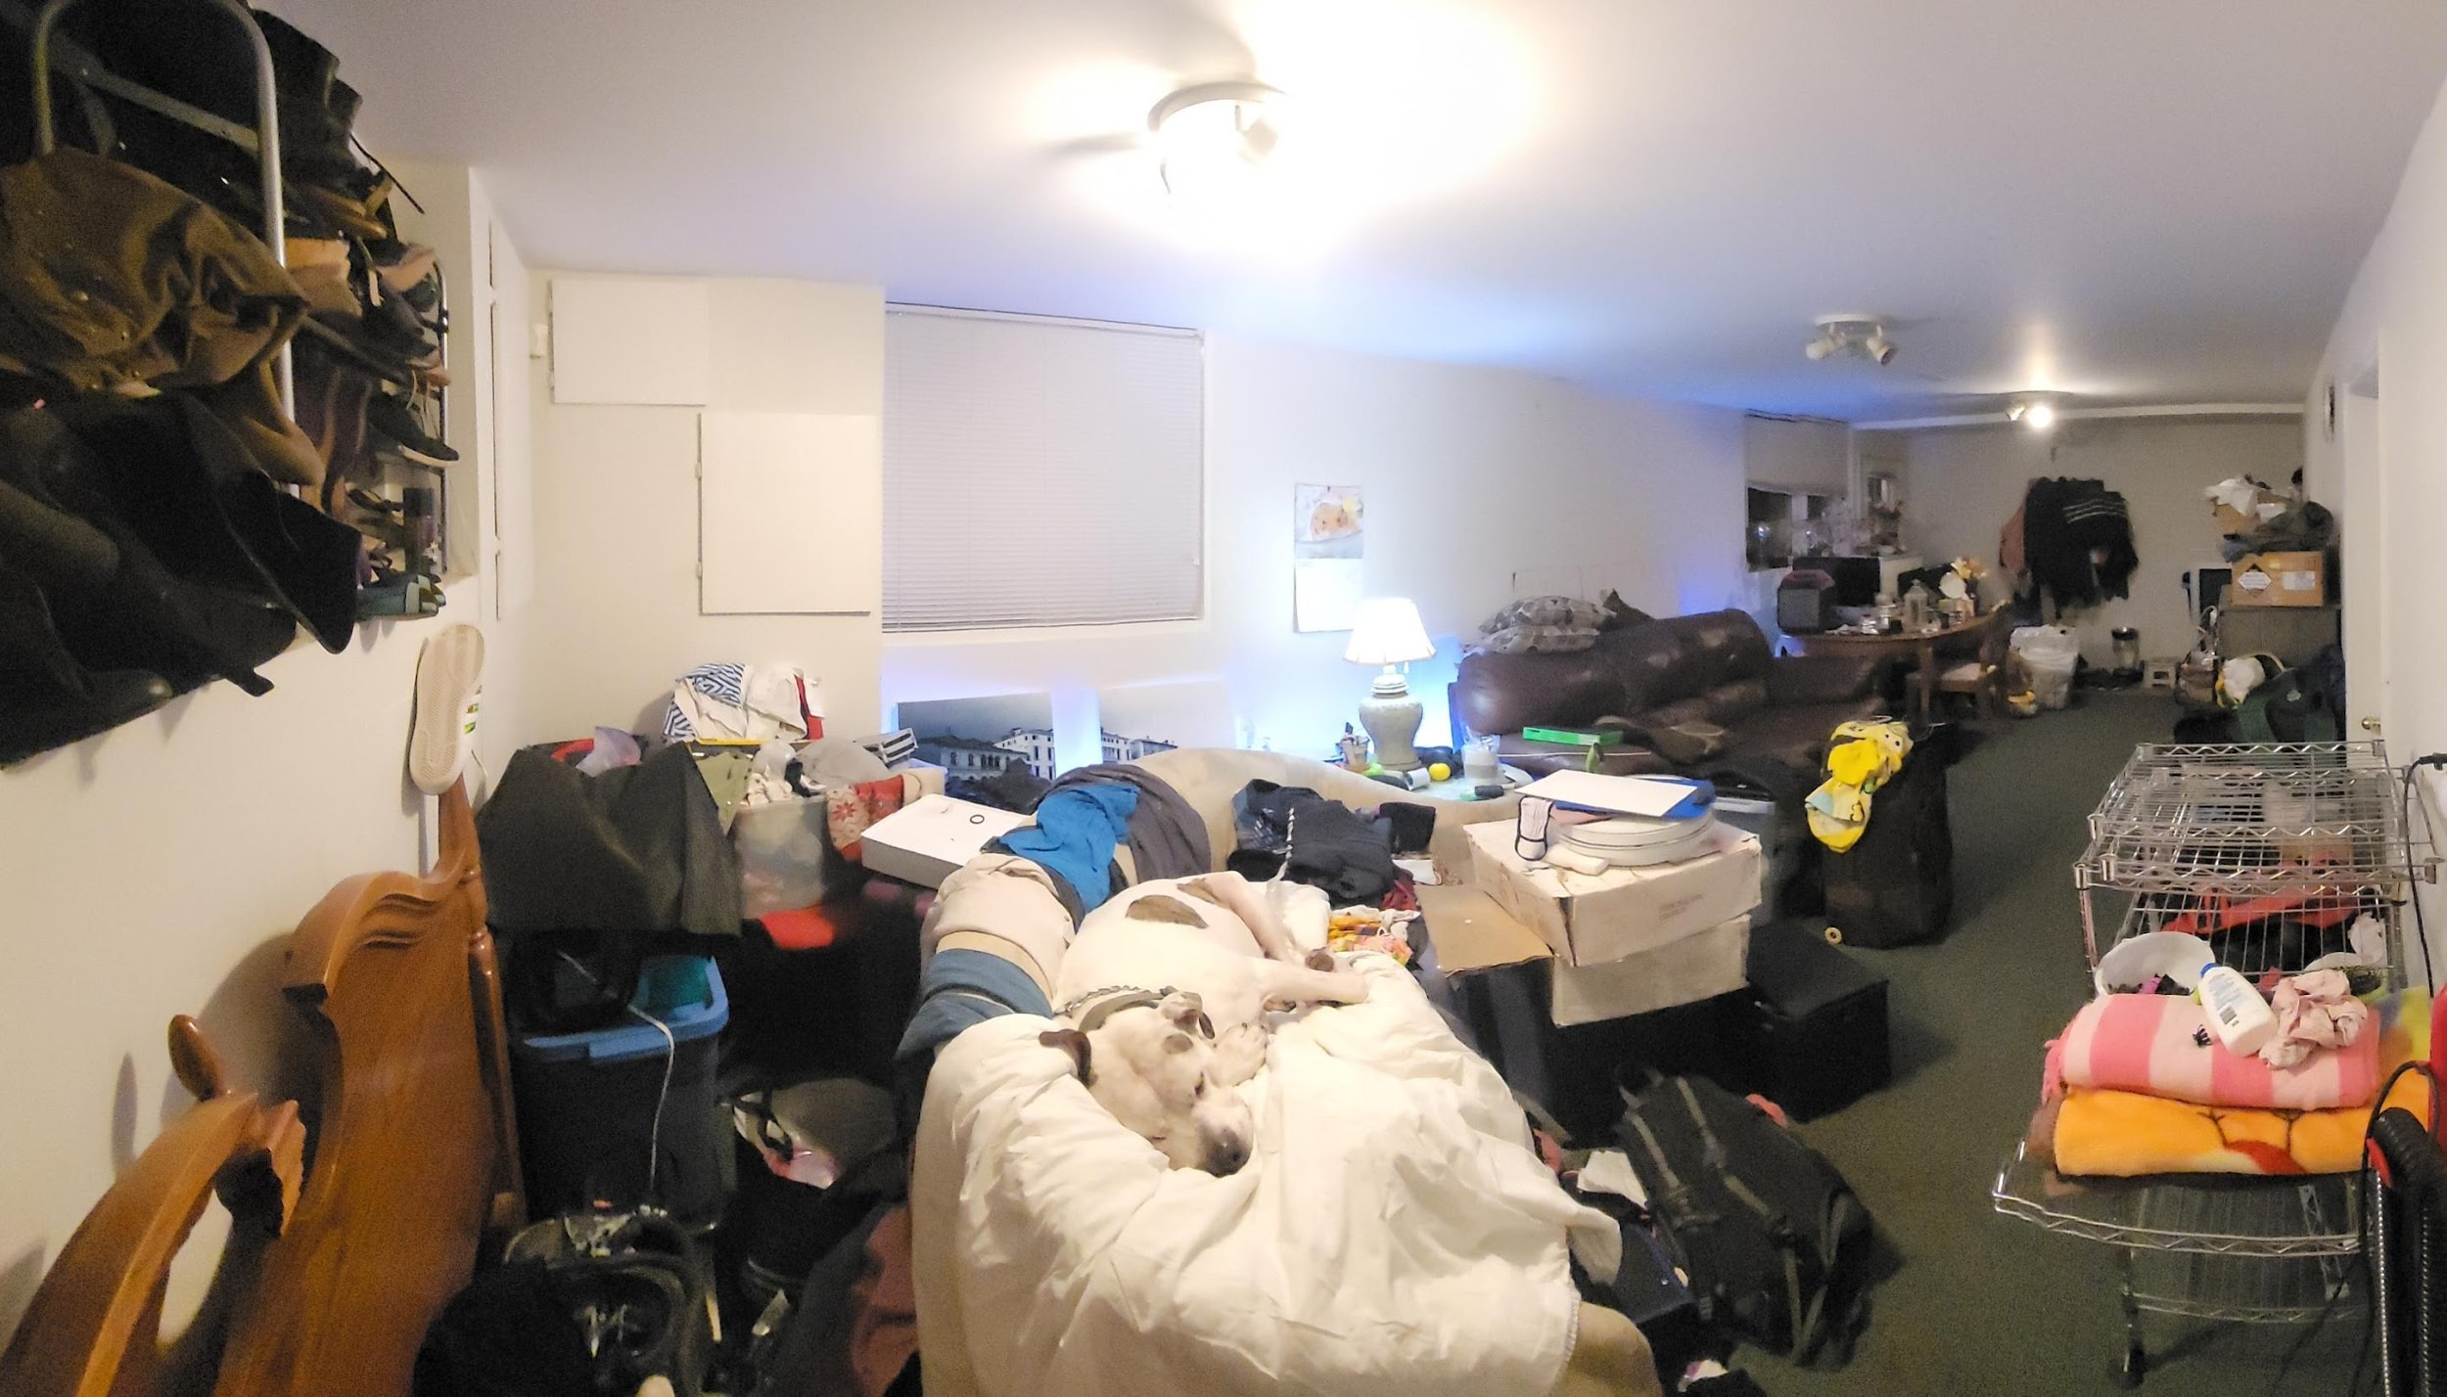
Tank (on the white blanket) weighs 125lbs, and his owner’s physical disability means he needs a fenced yard for exercise. As a result, his family pays $750/mo for an affordable rental like this one. The basement suite houses 6 people, 2 dogs, and 1 cat.

Slide 19
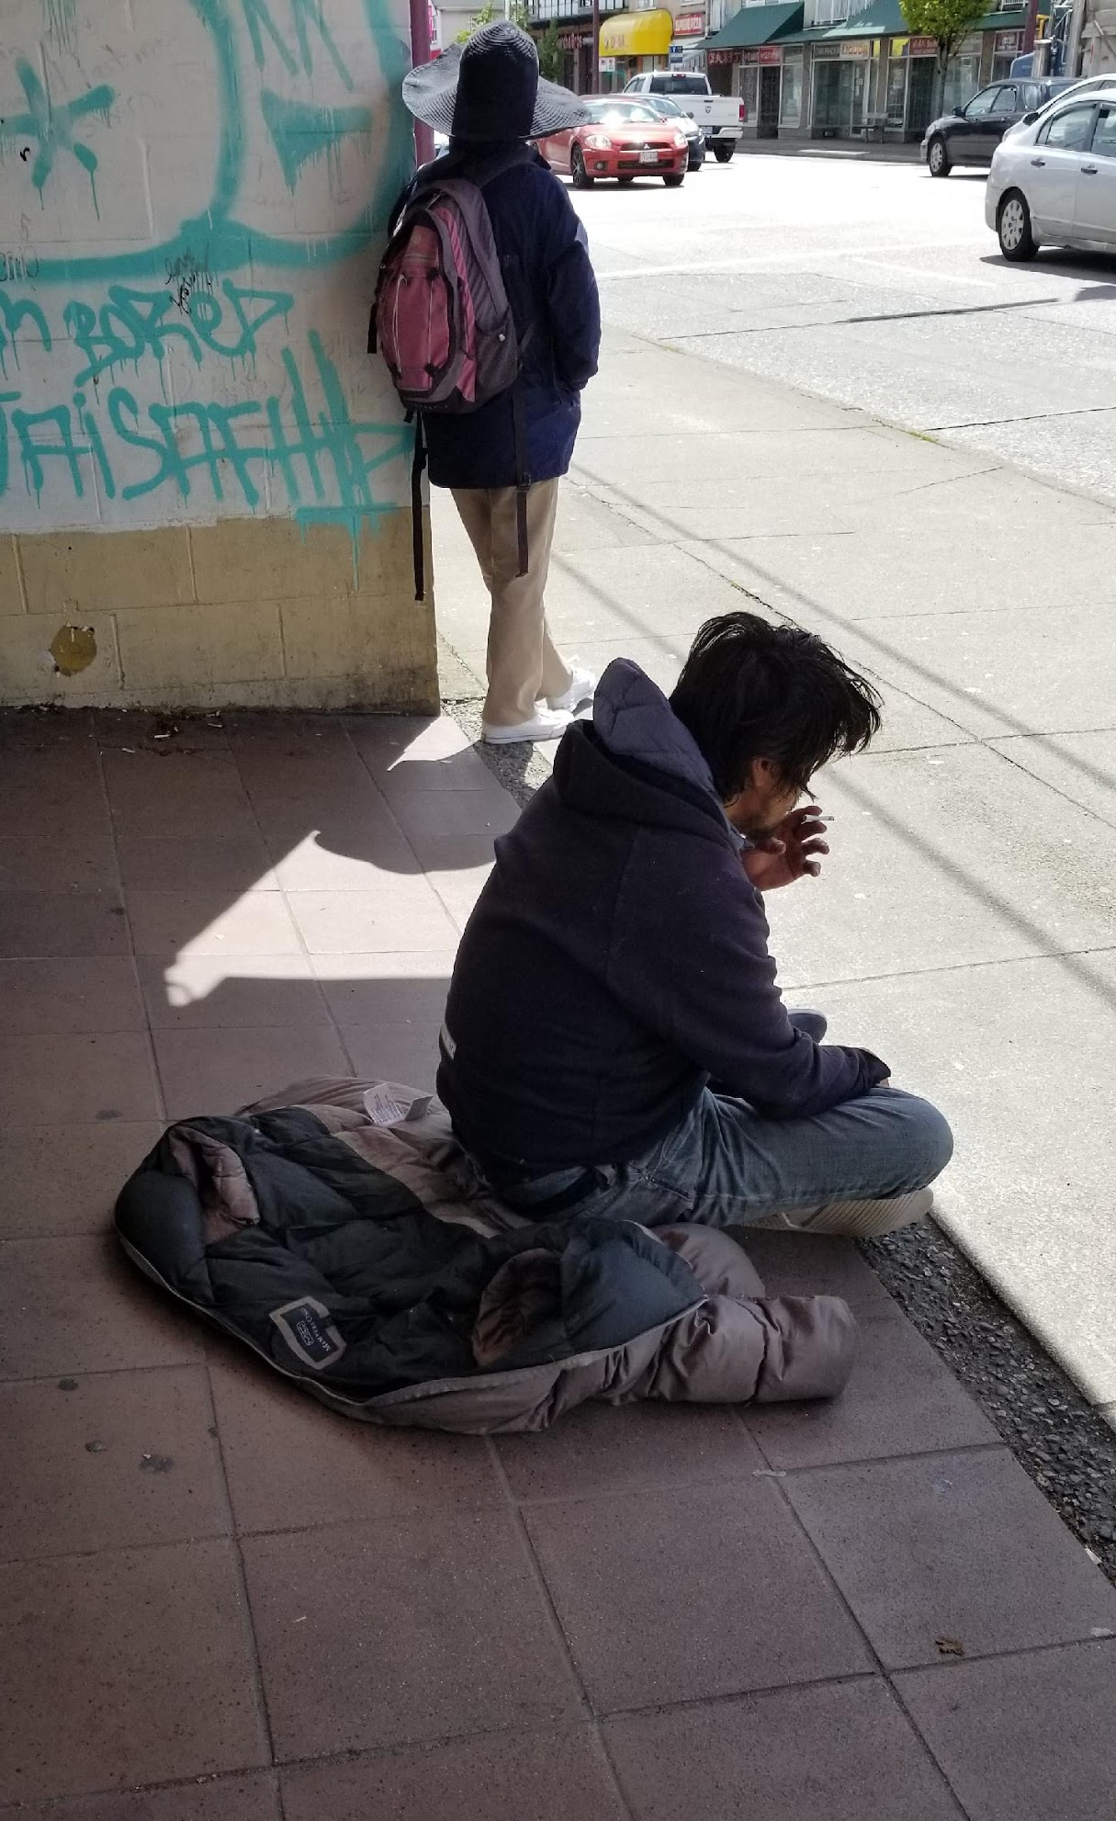
Local business sentiments
Most businesses surveyed did not feel homelessness seriously impacts their business. (Small sample, sorry!)
  2 had never noticed people they thought were homeless in the area. 3 said rarely.
  General safety concerns, complaints about substance use, hygiene.
24-hour businesses much more aware of the issues
  7 out of 7 surveyed interacted daily
  Many were more tolerant at night, may allow panhandling and loitering, even sleeping, but people have to move along by morning.
  Majority explain it’s out of concern for children.
  Other reasons: morning rush, they should have somewhere else to go during the day, it doesn’t look good.

Slide 20
Analysis
Even though there are very few resources to help them in South Vancouver, there is still a significant number of people experiencing homelessness who choose to spend their time here rather than in areas where more resources exist.
Many people come here because they have personal ties to this community, and their own history here.
Areas between E 41st and 49th Aves at Main, Fraser and Victoria Dr are known to the general community as where you will most likely find people who are experiencing homelessness. These areas are easily accessed by transit.

Slide 21
Some people feel safer sleeping on the streets here than in shelters Downtown, which explains why 24-hour businesses interact more with people they identify as homeless.
South Van is associated with less drug use, violence and crime, and they are not as likely to have to deal with police here.
We still have wide open spaces. It’s not crowded and people will generally leave you alone.
(There are also people who suffer from significant barriers, including serious mental illnesses, who may not have an understanding of how to access those services, and just feel more comfortable here.)

Slide 22
Takeaways
Mostly the general public is sympathetic, insofar as people are aware of homelessness in this area.
Neither individuals experiencing homelessness themselves, nor businesses or other members of our community, know where someone can go for help. Two major causes of this:
  There is a resource desert in South Vancouver when it comes to addressing homelessness, in all areas.
  The unique social and geographic characteristics of South Van make it very difficult to conduct outreach and disseminate information to isolated people who are not already accessing supports.

Slide 23
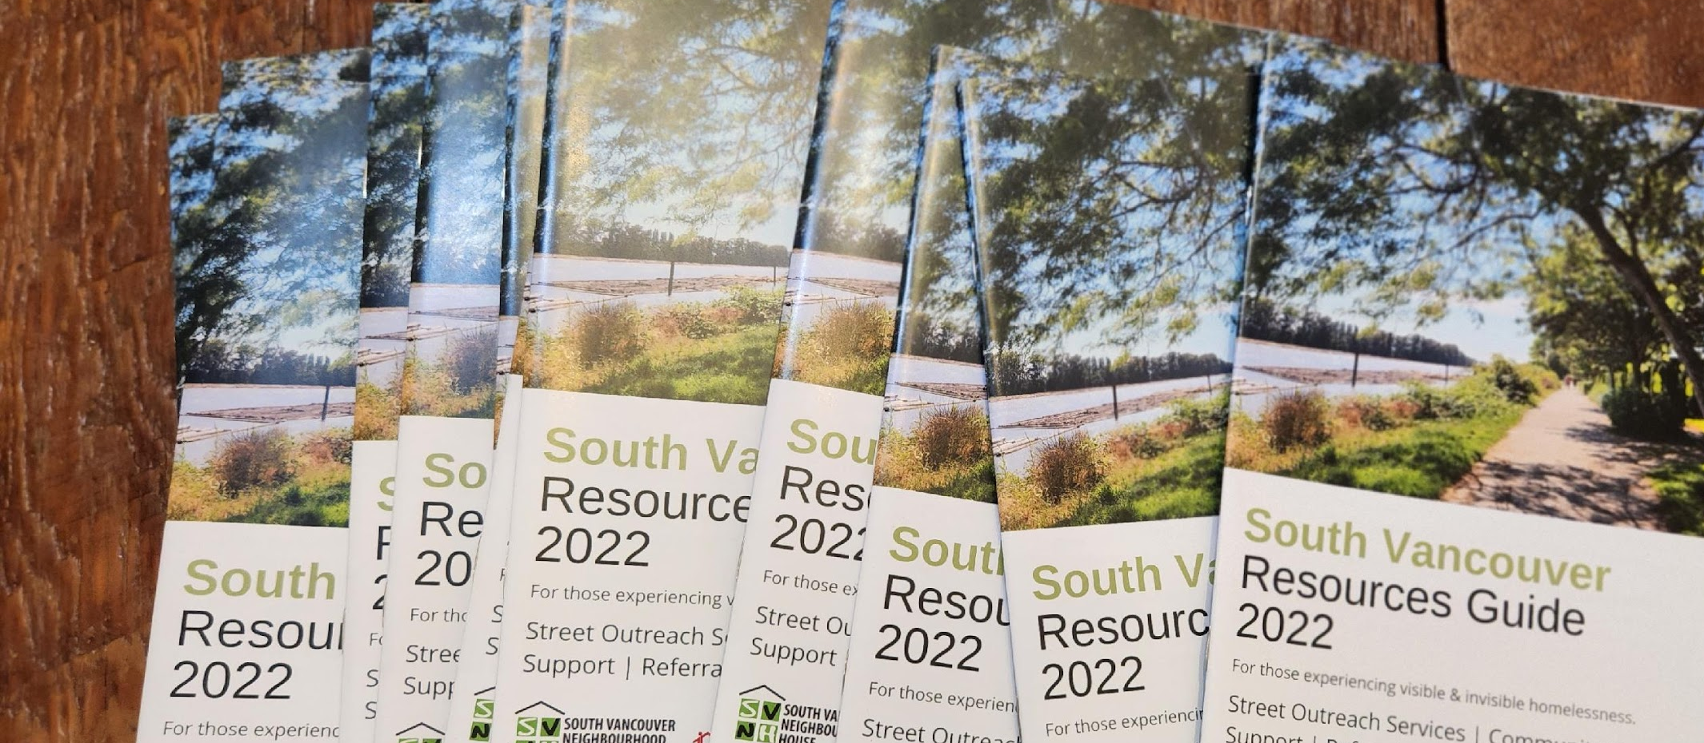
What we’ve done
The South Vancouver Resources Guide, published 2022
Publication of the South Vancouver Resource Guide
Biweekly Care and Share event at Killarney Community Center
October 2022 Hub collaborative luncheon
Community art workshop x2 (coming soon)
February 11th community symposium on homelessness in South Van

Slide 24
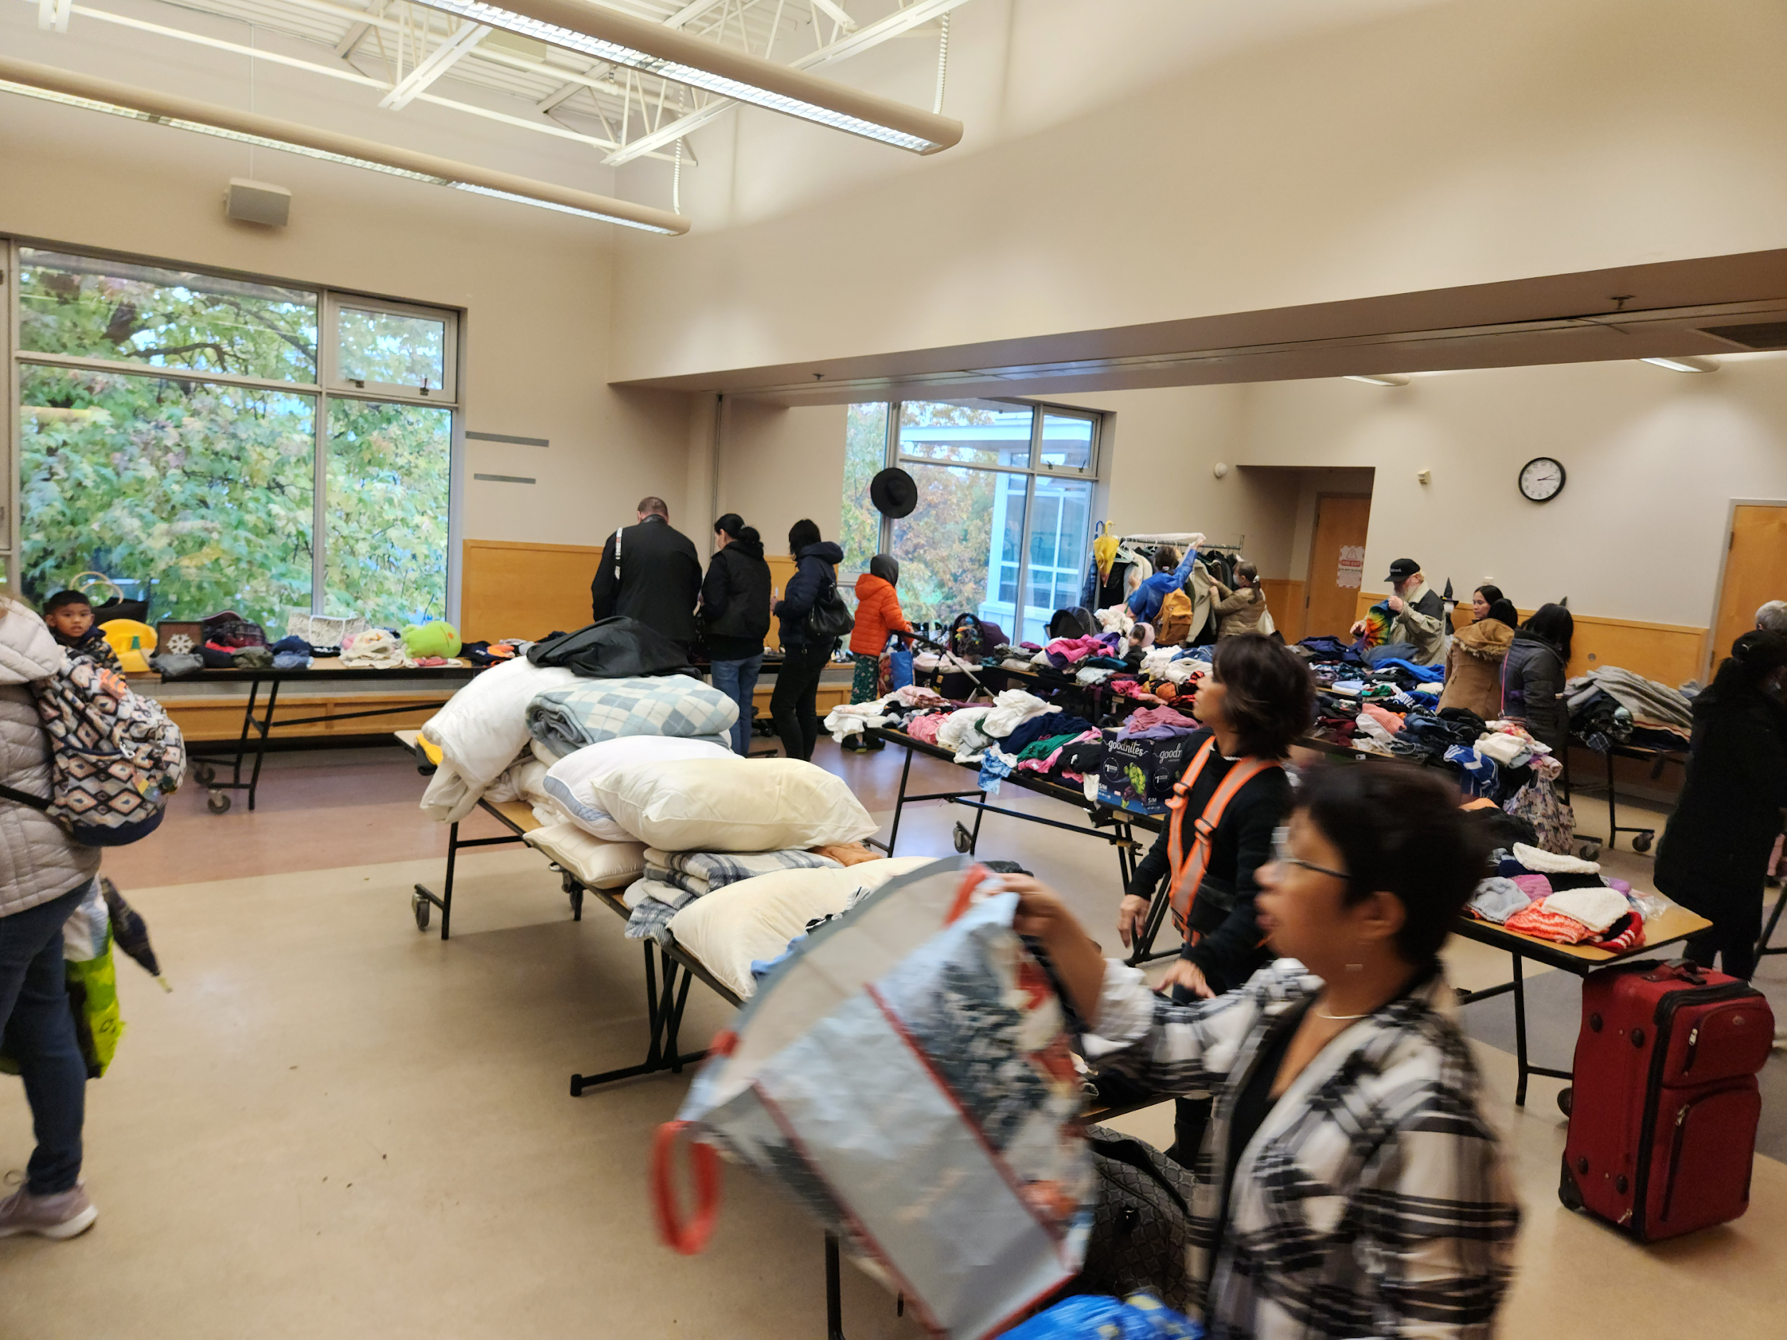
  CARE AND SHARE - A biweekly“free store”—donated clothes, toys, and useful household goods are collected at Killarney Community Center, then distributed by a team from SVNH and volunteers referred by Homelessness Hub partner organizations.
  100% free and open to everyone, regardless of housing status.

Slide 25
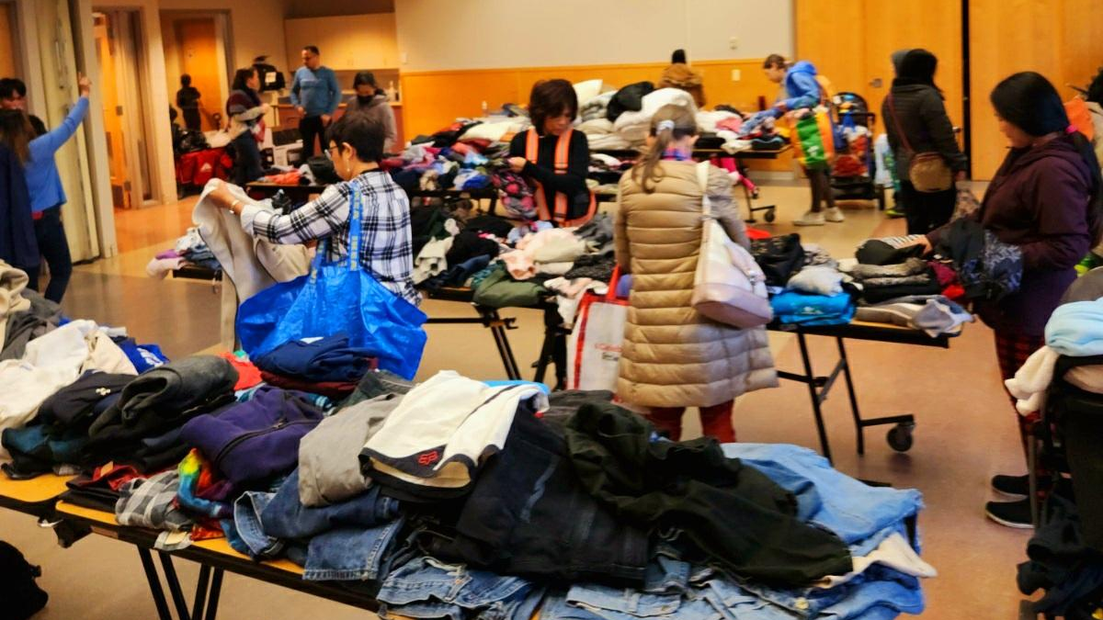

Slide 26


Slide 27
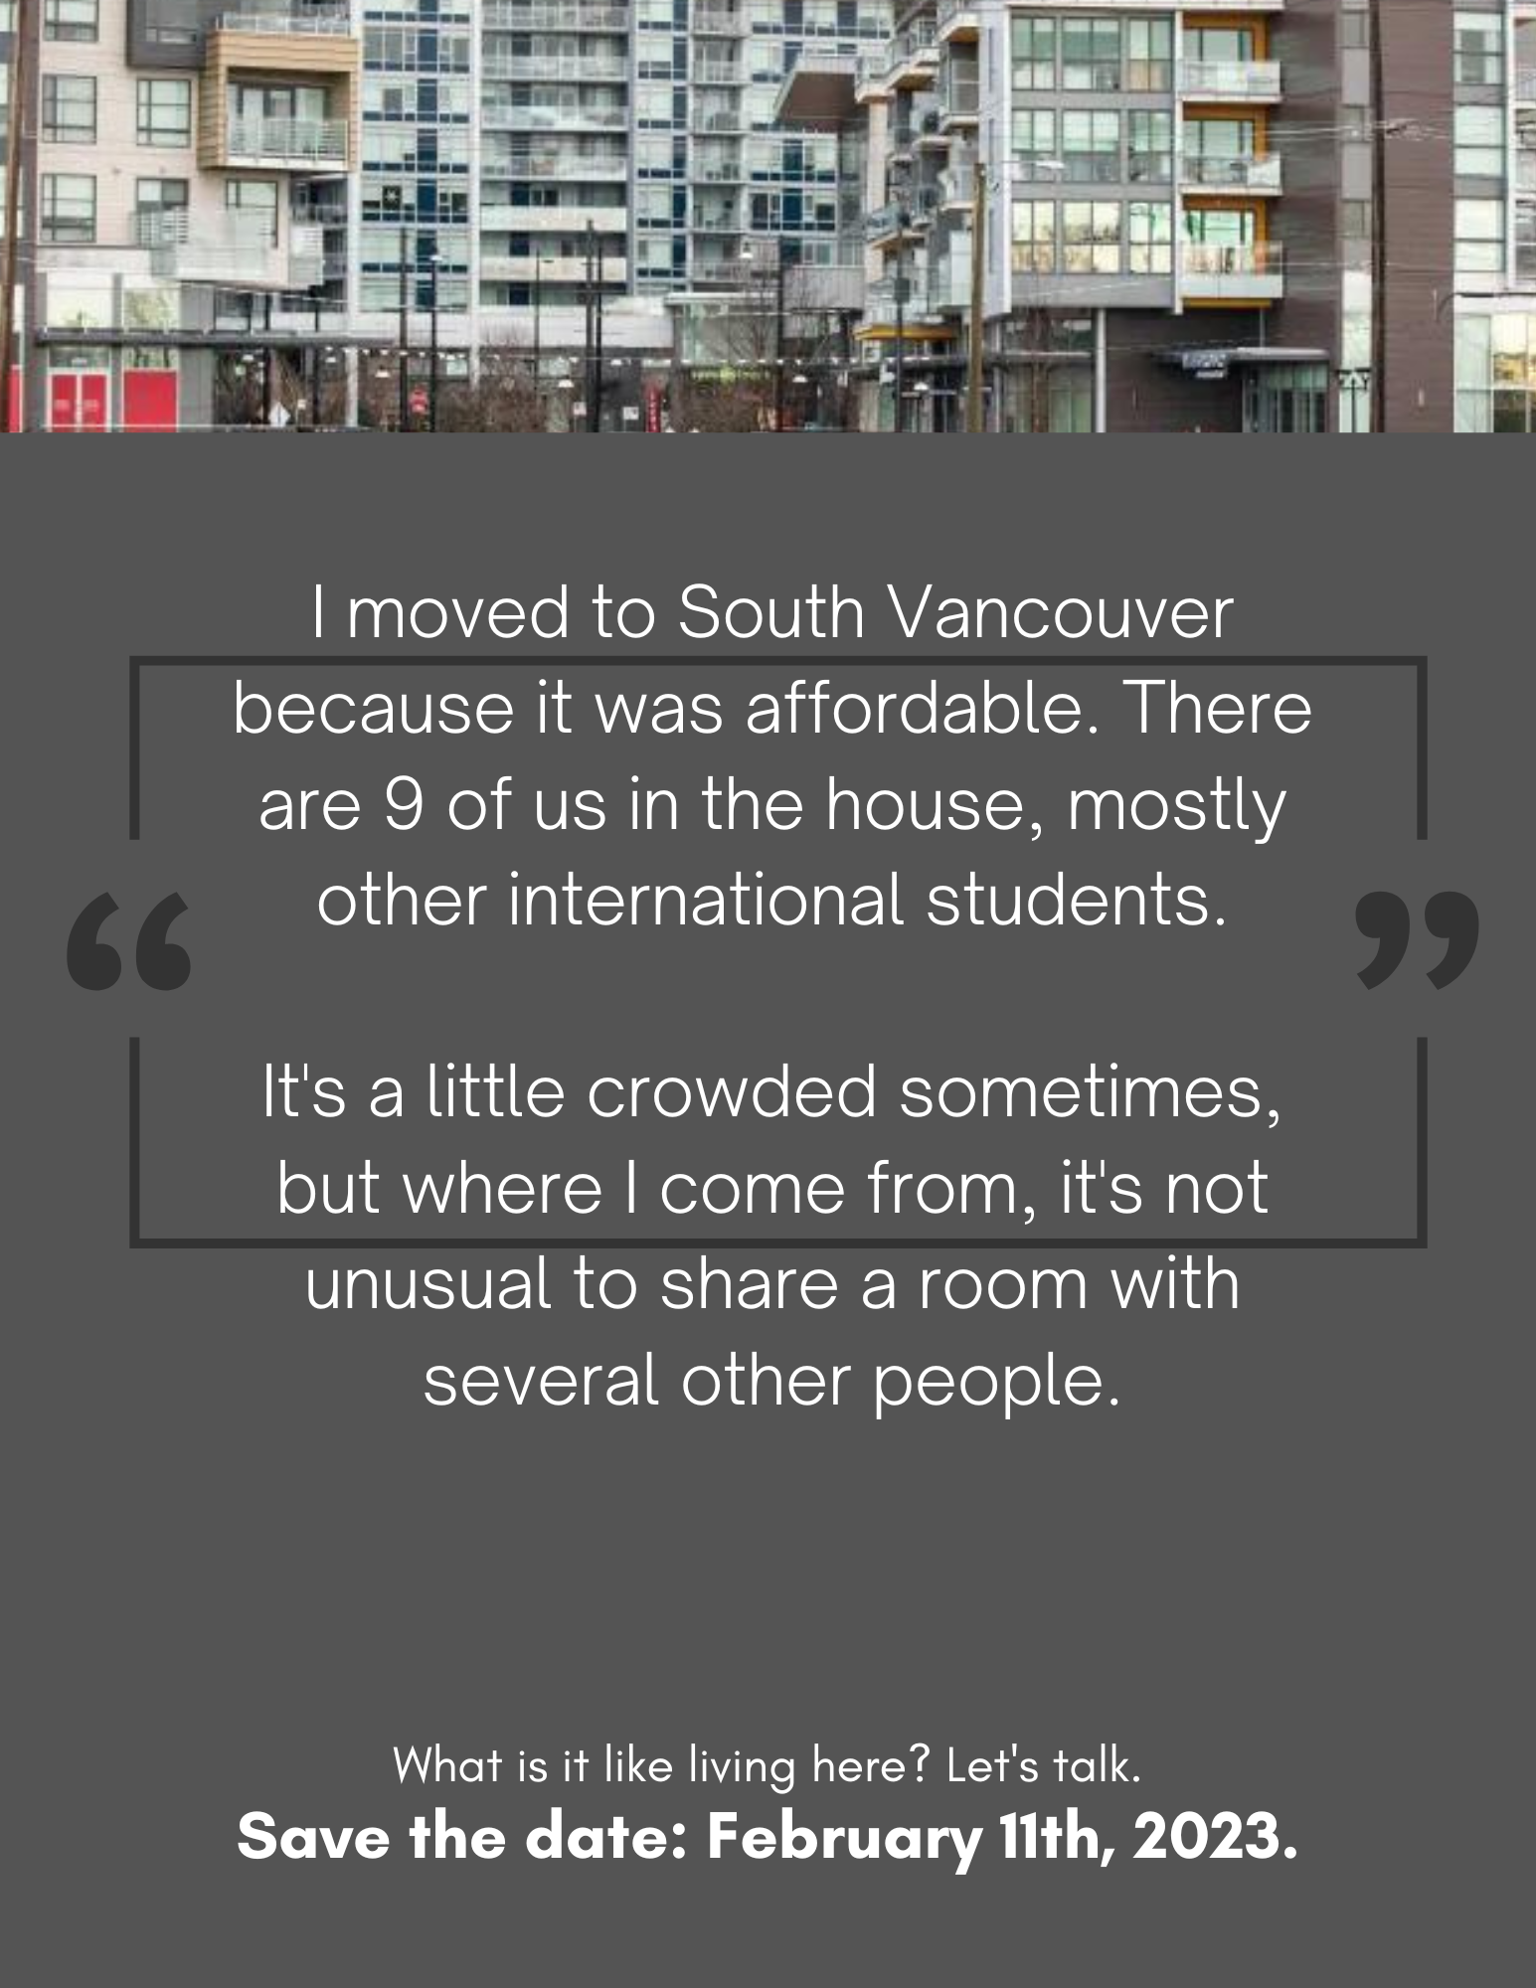


February 11th: a community symposium on homelessness. Information sharing, dialogue and capacity building in our community.

Slide 28
Remaining questions…
How can we make sure information about the existing resources actually gets to the people who need it?
How can we respond to the actual needs people have expressed?
What can the people of South Vancouver do to help?

